Slide 1



Bank Analytics & Debit and Credit Dashboard
GROUP 3
B Sreeram
Akshit Dubalgunde
Dharavath vinaykumar
Saumya Sherekar
Mayur Parshuram Pawar
Vikrant Sharma
Neetu shah
Kalpesh Rajkumar Berde

Slide 2






Introduction: Understanding Financial Flows
This presentation provides an overview of our financial landscape, focusing on debit and credit activities, loan performance, and key banking metrics.
Debit & Credit
Loan Performance
Branch Activity
Analyzing transaction volumes and ratios.
Insights into loan amounts, statuses, and demographics.
Performance across different bank branches.

Slide 3

Data Overview: Key Financial Metrics
751M
65.54K
756.41K
155.29M
Total Loan Amount
Funded
Total Loan
Total Collection
Total Interest

Slide 4
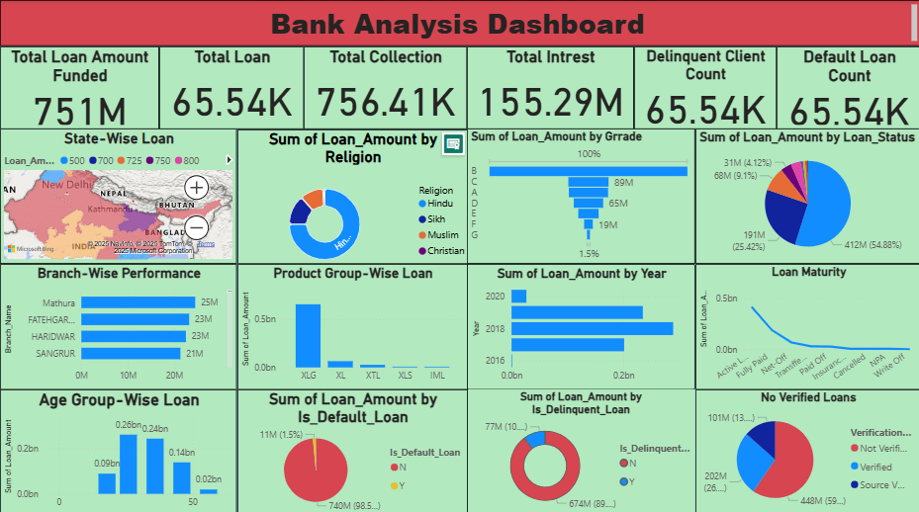

Slide 5
Data Overview: Key Financial Metrics
127.60M
127.29M
1.00
318.12K
Total Credit Amount
Total Debit Amount
Credit To Debit Ratio
Net Transaction Amount

Slide 6
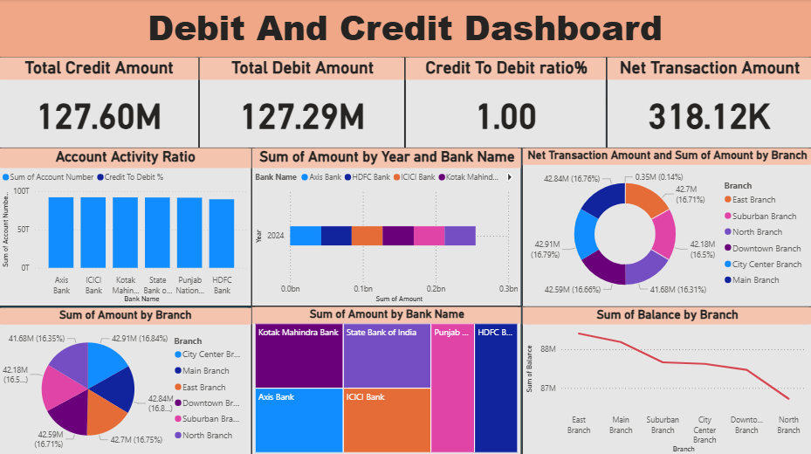

Slide 7
Objectives: Key Performance Indicators (KPIs)
Monitor Transaction Health
Analyse Bank Contribution
Total Credit Amount: ₹127.60M
Total Debit Amount: ₹127.29M
Net Transaction Amount: ₹318.12K
Top Contributors: Kotak Mahindra, SBI, ICICI, Axis, HDFC
Year-wise Transaction Trends: 2014–2016 breakdown by bank
Evaluate Branch Performance
Optimize Product Offerings
Highest Transaction Volume: Central Branch (₹27.5M, 21.6%)
Lowest Transaction Volume: Eastern Branch (₹23.3M, 18.3%)
Account Activity Ratio: 1.00
Credit to Debit %: 1.00

Slide 8


Process: Data Analysis Workflow
Data Collection
Gathering raw transaction and loan data from various sources.
Data Cleaning & Transformation
Ensuring data accuracy and preparing it for analysis.
Visualization & Reporting
Creating interactive dashboards and reports for insights.
Insight Generation
Identifying trends, anomalies, and actionable recommendations.

Slide 9
⚙ Process Workflow
Data Cleaning:
• Removed duplicates, mapped outcomes
• Mastered Power Query for handling messy datasets
Database Management & SQL:
• Skilled in managing high-volume data efficiently using MySQL
• Experienced in crafting advanced SQL queries to derive performance metrics
and actionable insights
Dashboard Design:
• Built interactive dashboards in Excel , Tableau and Power BI
• Learned to select the right charts for trends, comparisons, and KPIs
Project Management Skills:
• Executed end-to-end workflow: Raw Data → Cleaned Data → SQL Analysis →
Dashboards → Insights
• Developed a strong understanding of the value of clear documentation and
impactful data storytelling.

Slide 10
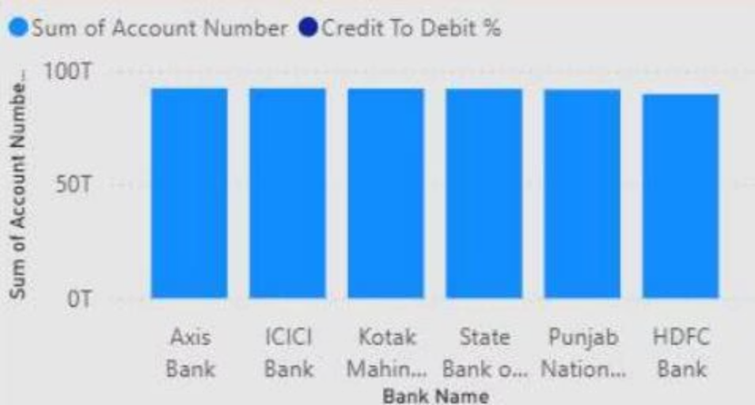
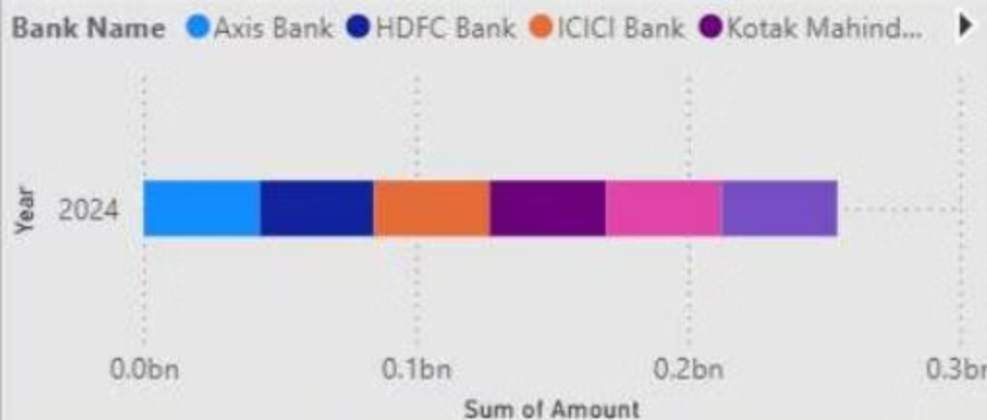
Analysis: Account Activity & Bank Performance
Account Activity Ratio by Bank
Sum of Amount by Year and Bank
A horizontal bar chart detailing the sum of amounts by bank for 2024, indicating individual bank contributions.
This chart illustrates the credit-to-debit ratio and account numbers across major banks, highlighting variations in activity.

Slide 11

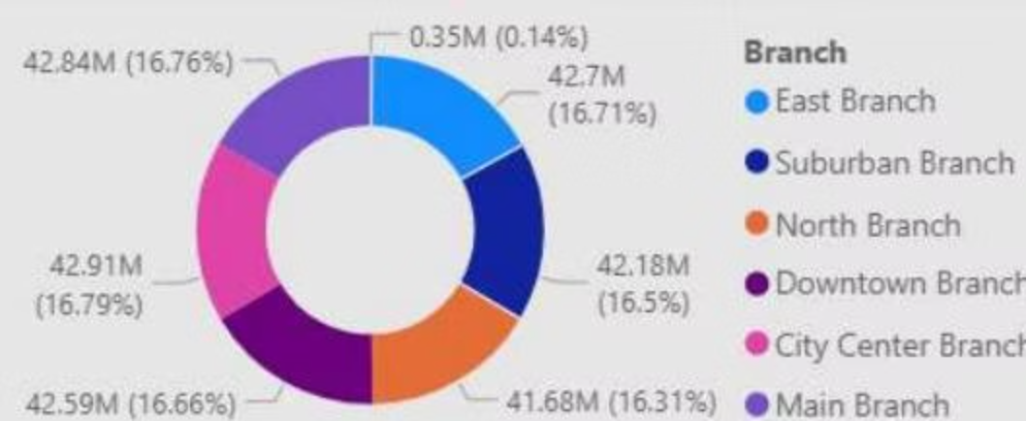
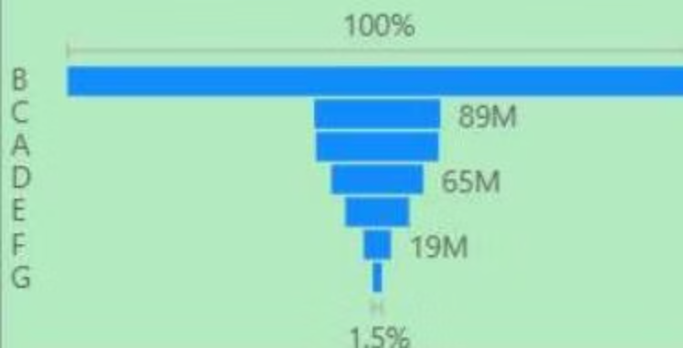
Analysis: Branch & Loan Distribution
Loan Amount by Religion & Grade
Net Transaction Amount by Branch
This donut chart breaks down net transaction amounts by branch, revealing the contribution of each location.
Loan distribution analyzed by religious demographics and credit grades, offering insights into customer segments.

Slide 12


Recommendations and Insights
Enhance Branch Performance
Refine Loan Product Strategy
Focus on underperforming branches to boost transaction volumes and balances.
Tailor loan products based on demographic and grade-wise distribution for better uptake.
Mitigate Default Risk
Improve Data Verification
Implement proactive measures for loans identified as delinquent or in default.
Increase the percentage of verified loans to reduce risk and improve portfolio quality.

Slide 13






Conclusion: Driving Financial Growth
Our analysis reveals a robust financial position with opportunities for targeted improvements in loan management and branch operations. By leveraging these insights, we can drive sustainable growth and enhance customer satisfaction.
Strategic Adjustments
Adapt strategies based on performance.
Continuous Monitoring
Regularly review dashboard metrics.
Achieve Targets
Work towards set financial objectives.

Slide 14


Challenges & Learnings
Data Integration
Dynamic Market
Integrating disparate data sources was a key challenge, requiring robust ETL processes.
The rapidly changing financial market necessitates agile reporting and analysis.
Actionable Insights
Learning to translate complex data into clear, actionable business recommendations.

